Slide 1
SER 334 A Session
SI Session
Monday, February 19th 2024
7:00 pm - 8:00 pm MST

Slide 2
{
Agenda
Review CPU Scheduling
Review Paging & Virtual Memory
Disk Scheduling
RAID

Slide 3
SI Session Expectations
Thanks for coming to the SER 334 SI session. We have a packed agenda and we are going to try to get through as many of our planned example problems as possible. This session will be recorded and shared with others.
If after this you want to see additional examples, please visit the drop-in tutoring center.
We will post the link in the chat now and at the end of the session.
tutoring.asu.edu
Please keep in mind we are recording this session and it will be made available for you to review 24-48 hours after this session concludes.
Finally, please be respectful to each other during the session.

Slide 4

Interact with us:
Zoom Features
Zoom Chat
Use the chat feature to interact with the presenter and respond to presenter’s questions.
Annotations are encouraged

Slide 5
Shortest Job First LIVE
T_{n} = 15
SER 334
Scheduling Algorithms
T_{n+1}= a(t_{n}) + (1 - a)T_{n}
t_{n} = actual burst, T_{n} = CPU guess, a = weight (usually 0.5)
P0, 20
P1, 8
P2, 7
P3, 13
3
1
0
2

Slide 6
Shortest Job First LIVE
T_{n} = 15
SER 334
Scheduling Algorithms
T_{n+1}= a(t_{n}) + (1 - a)T_{n}
t_{n} = actual burst, T_{n} = CPU guess, a = weight (usually 0.5)
P0, 20
P1, 8
P2, 7
P3, 13
3
1
0
2
n=0
T_{n+1}= a(t_{n}) + (1 - a)T_{n}
T₁= (0.5)(7) + (0.5)15
T₁= 11

Slide 7
Shortest Job First LIVE
T_{n} = 15
SER 334
Scheduling Algorithms
T_{n+1}= a(t_{n}) + (1 - a)T_{n}
t_{n} = actual burst, T_{n} = CPU guess, a = weight (usually 0.5)
P0, 20
P1, 8
P2, 7
P3, 13
3
1
0
2
n=0
n=1
T_{n+1}= a(t_{n}) + (1 - a)T_{n}
T_{n+1}= a(t_{n}) + (1 - a)T_{n}
T₁= (0.5)(7) + (0.5)15
T₁= (0.5)(8) + (0.5)11
T₁= 11
T₁= 9.5

Slide 8
Shortest Job First LIVE
T_{n} = 15
SER 334
Scheduling Algorithms
T_{n+1}= a(t_{n}) + (1 - a)T_{n}
t_{n} = actual burst, T_{n} = CPU guess, a = weight (usually 0.5)
P0, 20
P1, 8
P2, 7
P3, 13
3
1
0
2
n=0
n=1
n=2
T_{n+1}= a(t_{n}) + (1 - a)T_{n}
T_{n+1}= a(t_{n}) + (1 - a)T_{n}
T_{n+1}= a(t_{n}) + (1 - a)T_{n}
T₁= (0.5)(7) + (0.5)15
T₁= (0.5)(8) + (0.5)11
T₁= (0.5)(13) + (0.5)9.5
T₁= 11
T₁= 9.5
T₁= 8.875

Slide 9
Shortest Job First LIVE
T_{n} = 15
SER 334
Scheduling Algorithms
T_{n+1}= a(t_{n}) + (1 - a)T_{n}
t_{n} = actual burst, T_{n} = CPU guess, a = weight (usually 0.5)
P0, 20
P1, 8
P2, 7
P3, 13
3
1
0
2
n=0
n=1
n=2
n=3
T_{n+1}= a(t_{n}) + (1 - a)T_{n}
T_{n+1}= a(t_{n}) + (1 - a)T_{n}
T_{n+1}= a(t_{n}) + (1 - a)T_{n}
T_{n+1}= a(t_{n}) + (1 - a)T_{n}
T₁= (0.5)(7) + (0.5)15
T₁= (0.5)(8) + (0.5)11
T₁= (0.5)(13) + (0.5)9.5
T₁= (0.5)(20) + (0.5)8.875
T₁= 11
T₁= 9.5
T₁= 8.875
T₁= 11

Slide 10
Shortest Job First LIVE
T_{n} = 15
SER 334
Scheduling Algorithms
T_{n+1}= a(t_{n}) + (1 - a)T_{n}
t_{n} = actual burst, T_{n} = CPU guess, a = weight (usually 0.5)
P0, 20
P1, 8
P2, 7
P3, 13
3
1
0
2
T₁= 11
T₁= 9.5
T₁= 8.875
T₁= 11
Notes:
turnaround : end times! → 7+8+13+20 = 48/4 = 12
Waiting: start → 28/4=7

Slide 11
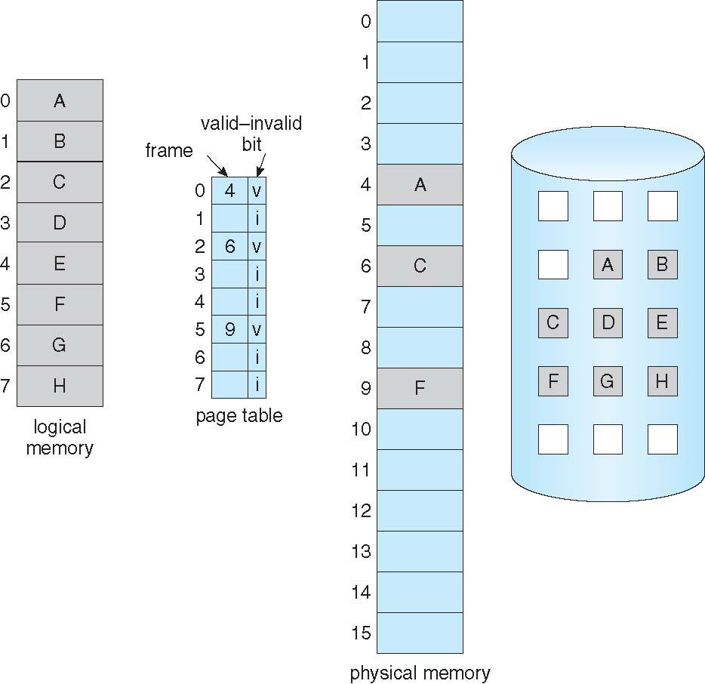
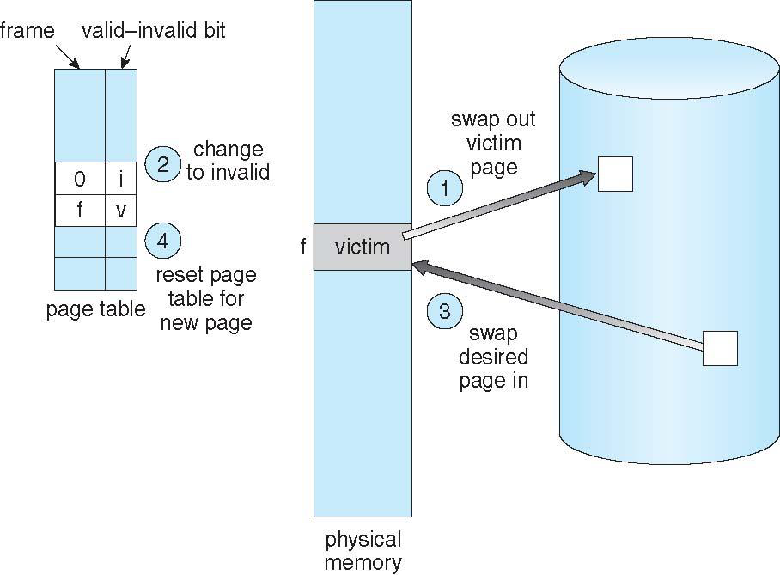
SER 334
Paging Refresher

Slide 12
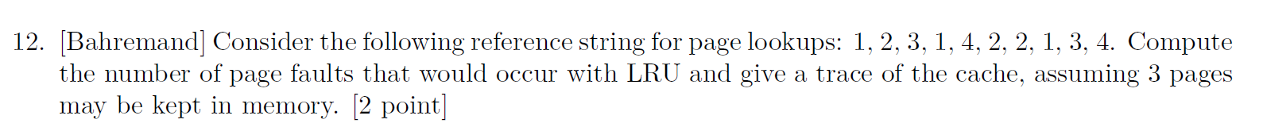
Module 11 Sample
SER 334
Practice Problems

Slide 13
Module 11 Sample
SER 334
Practice Problems
1
1
x

Slide 14
Module 11 Sample
SER 334
Practice Problems
1
2
1 | 1
 | 2
x | x

Slide 15
Module 11 Sample
SER 334
Practice Problems
1
2
3
1 | 1 | 1
 | 2 | 2
 |  | 3
x | x | x

Slide 16
Module 11 Sample
SER 334
Practice Problems
1
2
3
1
1 | 1 | 1 | 1
 | 2 | 2 | 2
 |  | 3 | 3
x | x | x | ✔

Slide 17
Module 11 Sample
SER 334
Practice Problems
1
2
3
1
4
1 | 1 | 1 | 1 | 1
 | 2 | 2 | 2 | 4
 |  | 3 | 3 | 3
x | x | x | ✔ | x
2

Slide 18
Module 11 Sample
SER 334
Practice Problems
1
2
3
1
4
2
1 | 1 | 1 | 1 | 1 | 1
 | 2 | 2 | 2 | 4 | 4
 |  | 3 | 3 | 3 | 2
x | x | x | ✔ | x | x
3

Slide 19
Module 11 Sample
SER 334
Practice Problems
1
2
3
1
4
2
2
1 | 1 | 1 | 1 | 1 | 1 | 1
 | 2 | 2 | 2 | 4 | 4 | 4
 |  | 3 | 3 | 3 | 2 | 2
x | x | x | ✔ | x | x | ✔

Slide 20
Module 11 Sample
SER 334
Practice Problems
1
2
3
1
4
2
2
1
1 | 1 | 1 | 1 | 1 | 1 | 1 | 1
 | 2 | 2 | 2 | 4 | 4 | 4 | 4
 |  | 3 | 3 | 3 | 2 | 2 | 2
x | x | x | ✔ | x | x | ✔ | ✔

Slide 21
Module 11 Sample
SER 334
Practice Problems
1
2
3
1
4
2
2
1
3
1 | 1 | 1 | 1 | 1 | 1 | 1 | 1 | 1
 | 2 | 2 | 2 | 4 | 4 | 4 | 4 | 3
 |  | 3 | 3 | 3 | 2 | 2 | 2 | 2
x | x | x | ✔ | x | x | ✔ | ✔ | x
4

Slide 22
Module 11 Sample
SER 334
Practice Problems
1
2
3
1
4
2
2
1
3
4
1 | 1 | 1 | 1 | 1 | 1 | 1 | 1 | 1 | 1
 | 2 | 2 | 2 | 4 | 4 | 4 | 4 | 3 | 3
 |  | 3 | 3 | 3 | 2 | 2 | 2 | 2 | 4
x | x | x | ✔ | x | x | ✔ | ✔ | x | x
2
Notes:
7

Slide 23
Module 11 Sample
SER 334
Practice Problems
Notes:
5

Slide 24
Types of Disk Scheduling?
SER 334
Disk Scheduling
First Come First Served
In order of request arrival
Shortest SEEK TIME First
Closest request is processed next
SCAN
Closest requests to the left, then closest requests to the right
C-SCAN
Closest requests to the right, then snap back to left edge
LOOK
C-SCAN but stops at last request and does not hit the edge

Slide 25
Module 12 Sample
SER 334
Sample Problems
Total:
4. [Acuña] Consider using the SSTF disk scheduling algorithm on the cylinder blocks 18, 43, 70, 55, 27, 33, 58, 44. What cylinder order would be produced, and how far would the disk head need to travel? Assume the disk head is initially at 25, and that the disk has cylinders 1 to 100. [2 points]

Slide 26
Module 12 Sample
SER 334
Sample Problems
Total:
5. [Lisonbee] Consider using the FCFS disk scheduling algorithm on the cylinder blocks 54, 23, 12, 128, 9, 66, 47, 18. What cylinder order would be produced, and how far would the disk head need to travel? Assume the disk head is initially at 43, and that the disk has cylinders 1 to 150. [2 points]

Slide 27


“Redundant Arrays of Independent Disks”
SER 334
RAID
Think:
Combining the Disks!
RAID 1
Mirroring
C
C
C

Slide 28
“Redundant Arrays of Independent Disks”
SER 334
RAID
Think:
Combining the Disks!
RAID 0
Striping

Slide 29
“Redundant Arrays of Independent Disks”
SER 334
RAID
Think:
Combining the Disks!
RAID 0+1
Stripe then Mirror
Notes:
0+1 is copy of the stripes as a whole, while 1+0 is individual copies of the

Slide 30
“Redundant Arrays of Independent Disks”
SER 334
RAID
Think:
Combining the Disks!
RAID 1+0
Mirror then Stripe
Notes:
Mirror over all, then stripe

Slide 31
“Redundant Arrays of Independent Disks”
SER 334
RAID
Think:
Combining the Disks!
RAID 1+0
Mirror then Stripe
Notes:
Mirror over all, then stripe

Slide 32
SER 334
Scratch Space

Slide 33
SER 334
Scratch Space

Slide 34
SER 334
Scratch Space

Slide 35
Upcoming Events
SI Sessions:
Sunday, February 25th at 7:00 pm MST - Q&A Session before Exam 3
Review Sessions:
Exam 3 Review: Thursday, February 22nd at 7:00 pm MST

Slide 36

Questions?
Survey:
http://bit.ly/ASN2324

Slide 37


More Questions?
Check out our other resources!
tutoring.asu.edu
1-
2-
Click on ‘Go to Zoom’ to log onto our Online Tutoring Center.
Click on ‘View the tutoring schedule’ to see when tutors are available for specific courses.

Slide 38
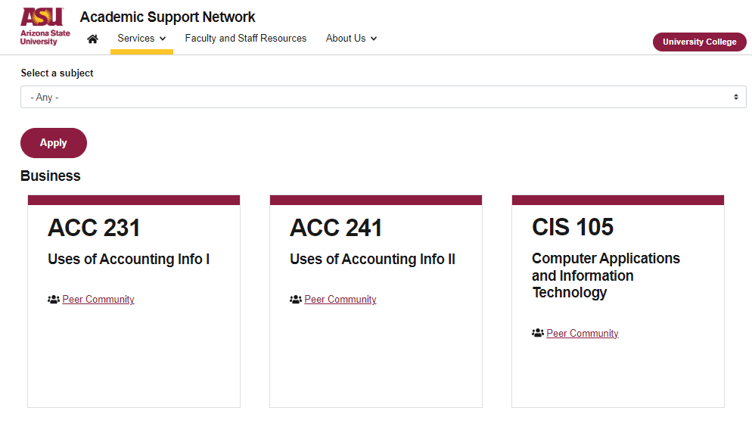

More Questions?
Check out our other resources!
tutoring.asu.edu/online-study-hub
Don’t forget to check out the Online Study Hub for additional resources!

Slide 39


Expanded Writing Support Available
Including Grammarly for Education, at no cost!
tutoring.asu.edu/expanded-writing-support
*Available slots for this pilot are limited

Slide 40
Additional Resources
Course Repo
Course Discord
BMP File Format (Wiki)
Linux Kernel API
Bootlin - Linux Cross Referencer
Dining Philosophers Interactive
Producer/Consumer Visual
Dave’s Garage Memory Video

